Slide 1
Cleaner App
Presented By :
Roshan Khatri
LC00017001252

Slide 2
Introduction
Its purpose is to offer a seamless and reliable platform for booking cleaning services.
It is a app created for small scale company to let users book cleaning service according to their requirement.

Slide 3
Objectives
I.Simplify the service booking process for quick scheduling.
II. Let userbook the service according to their requirement.

Slide 4
Scope
I.The app will provide a array of cleaning services.
II.The app will feature an intuitive and user-friendly interface, allowing seamless browsing, booking processes to enhance user convenience.
III.The app will establish a network of skilled and trustworthy cleaning professionals.

Slide 5
Limitations
I. All cleaning services may not be available.
II. Services may vary as per the cleaning professional.
III. May not be available in all geographical locations as app will be based on company’s location.
IV. May not be able to match all unique preference.

Slide 6
Technologies Used
Hardware Used:
Processor :
RAM : 8.00 GB
SSD : 256 GB
Software Used:
VS Code
Android immulator
Operating System-Windows
App UI: flutter
Backend: firebase auth, firebase database

Slide 7
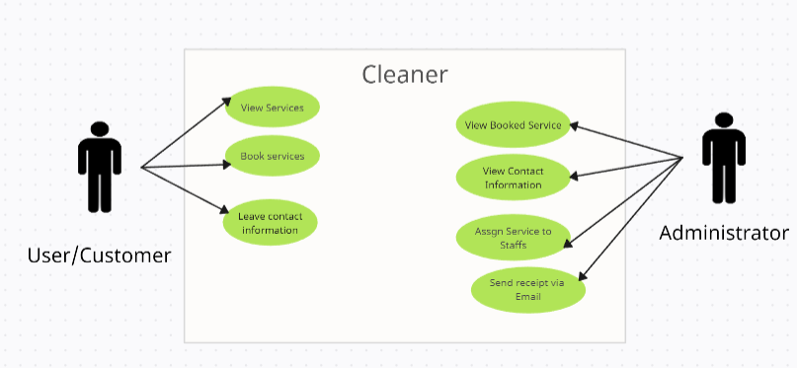
Functional Requirements using USE CASE DIAGRAM

Slide 8
Non-functional Requirements
Easy Interface
Less Response Time

Slide 9
Operational Feasibility
1.Cleaner is a mobile-based application which can be accessed from initially android mobile devices and then other mobile devices.
2.It is free of cost.
3.The system is GUI-based making the access to the system simpler and easier.

Slide 10
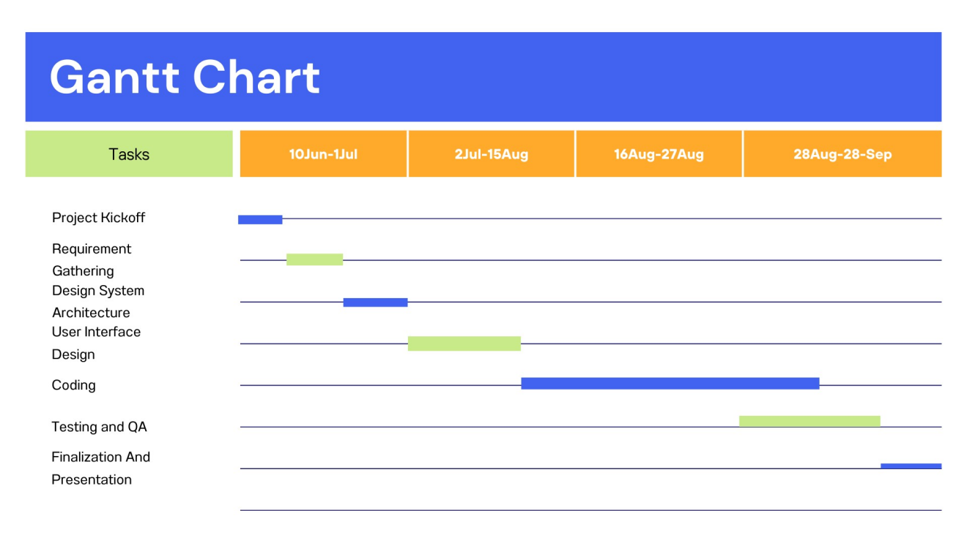
Schedule Feasibility

Slide 11
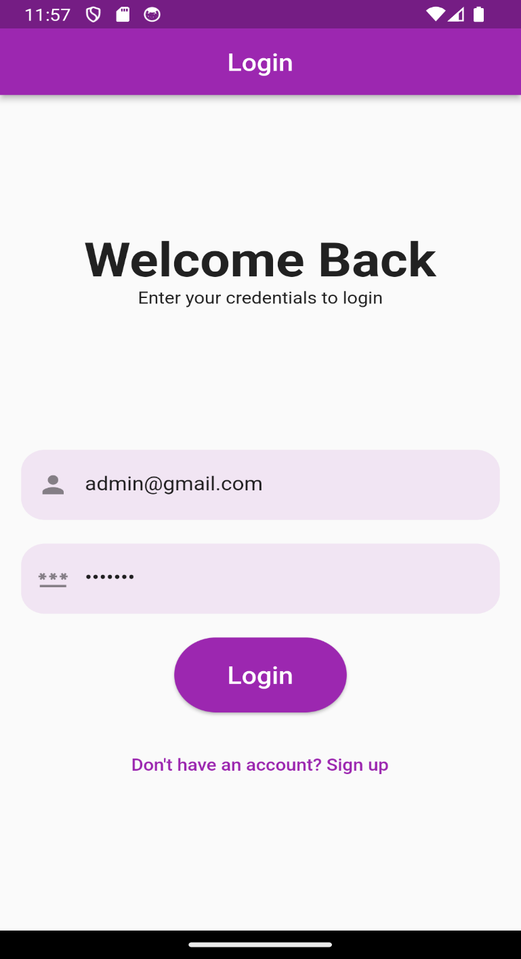
Login Page

Slide 12
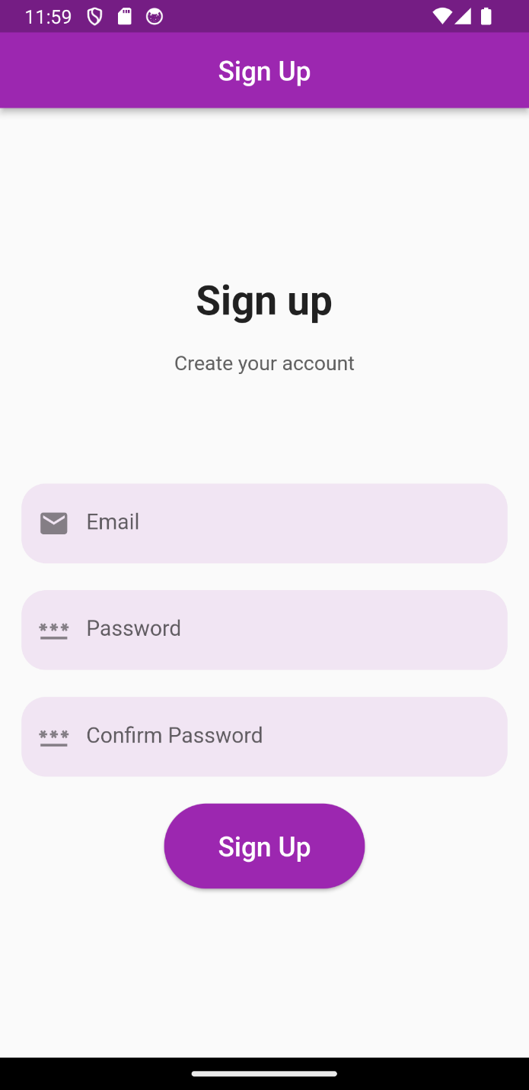
SignUp Page

Slide 13
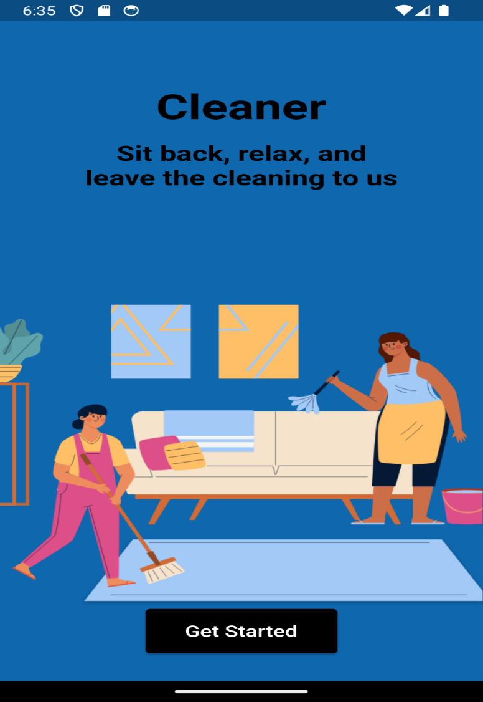
Splash Screen

Slide 14
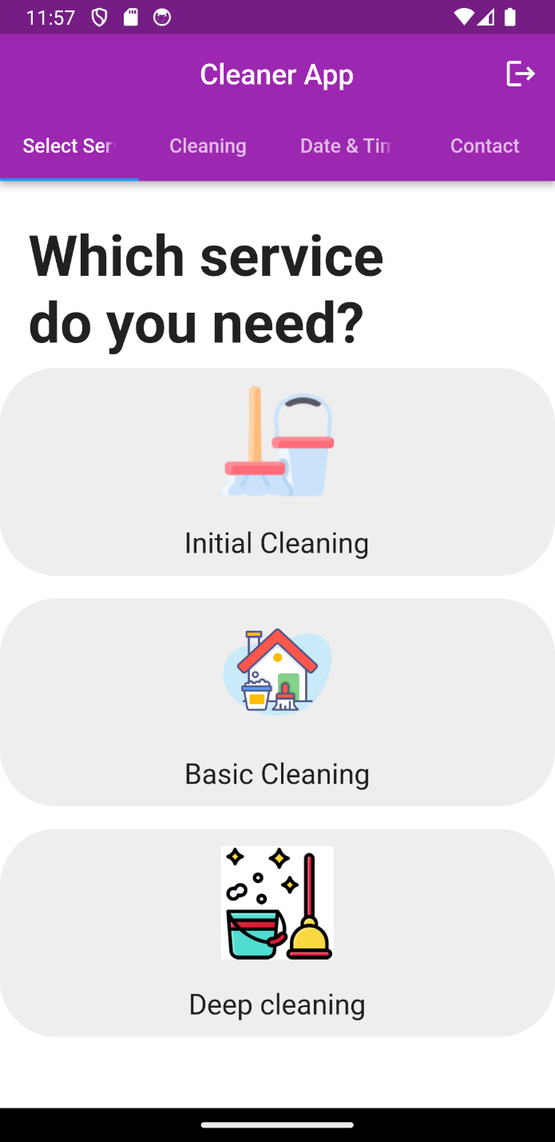
Select Service

Slide 15
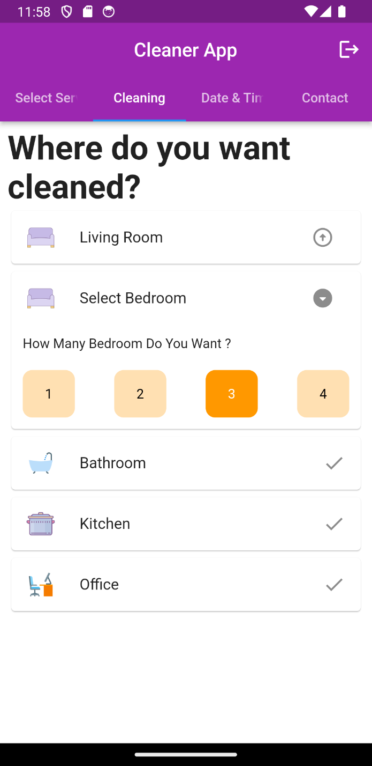
Customized Order

Slide 16
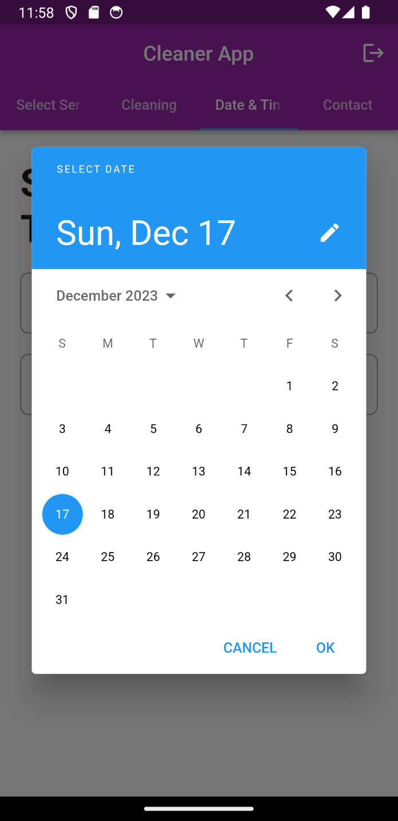
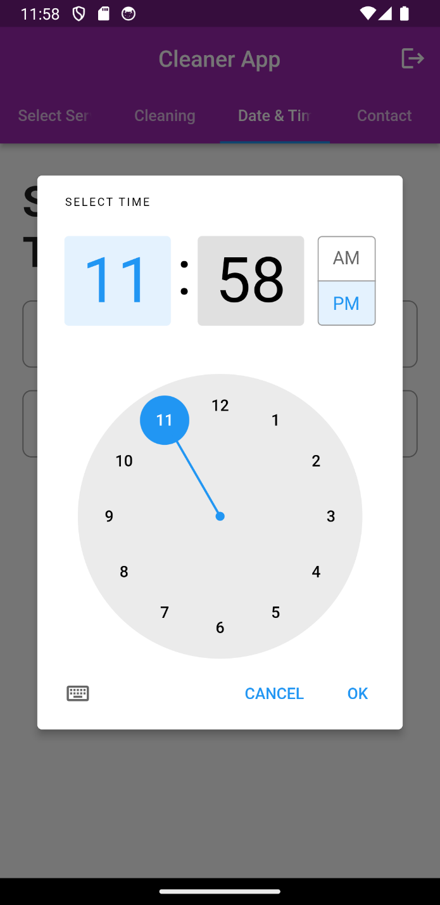
Scheduled System

Slide 17
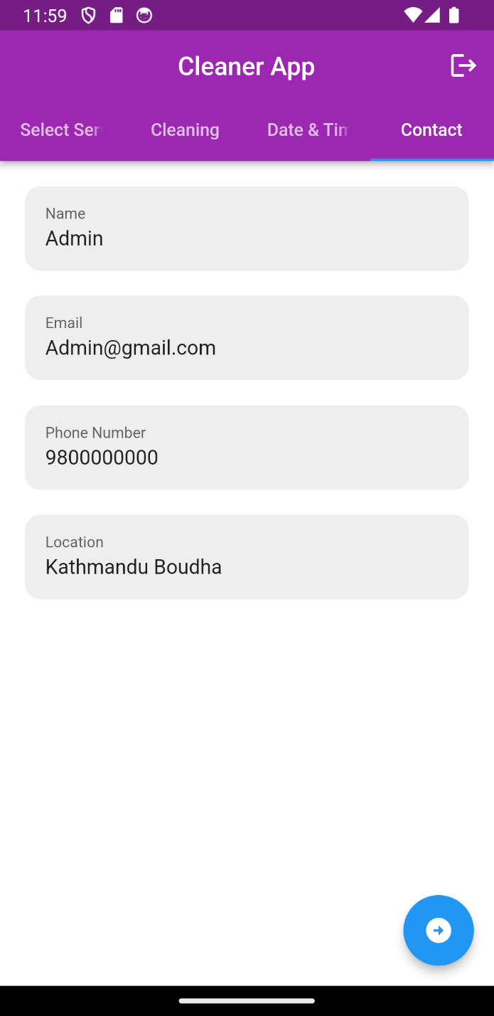
Contact Page

Slide 18
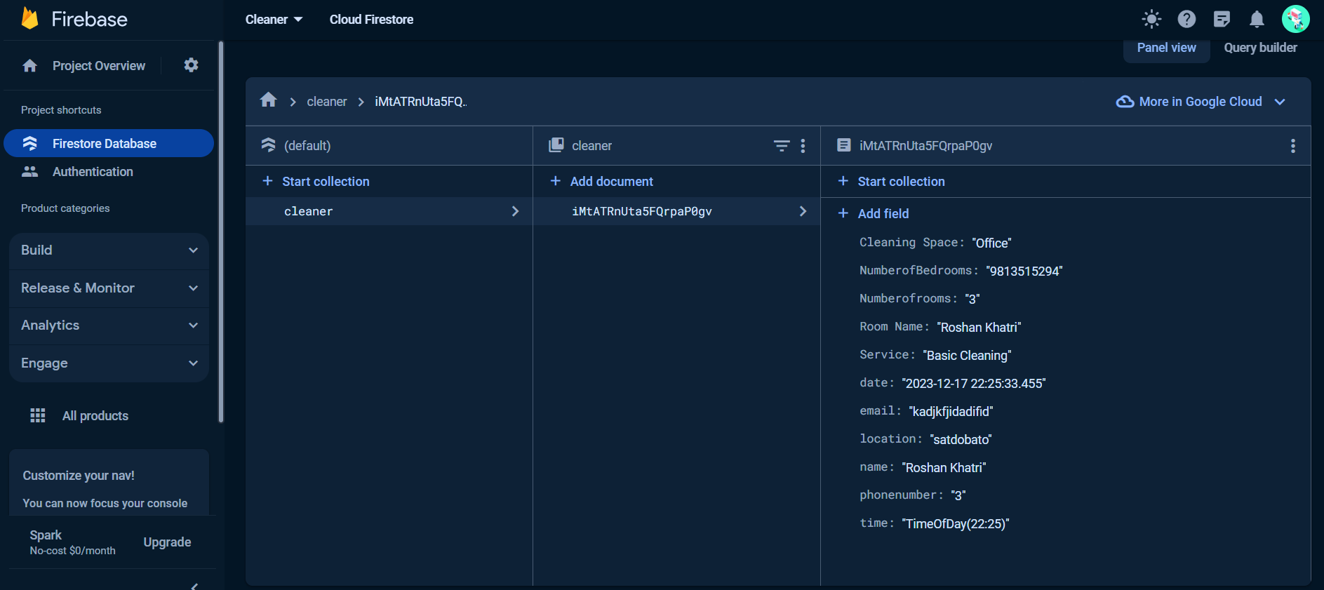
Dashboard

Slide 19
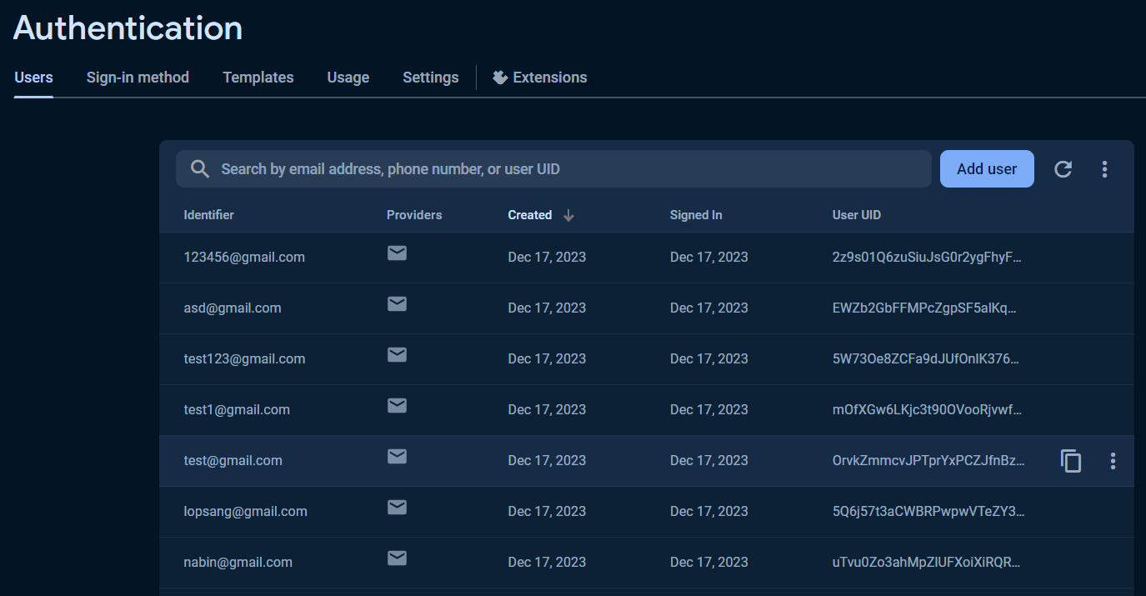
Dashboard

Slide 20
Remaining Tasks in App (Future Plan)
Show detailed service
Payment system
Personal detail profile setup

